Slide 1

Lecture 8： Partilce Filter Application： Monte Carlo Localization
Chapter 8
Department of Mechanical Engineering and Automation

Slide 2
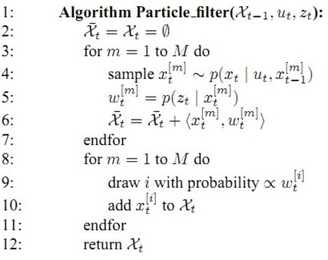
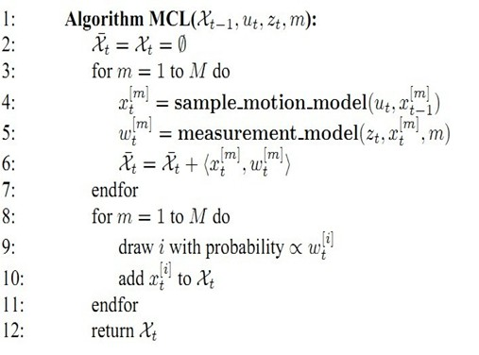
Monte Carlo Localization (MCL)

Slide 3
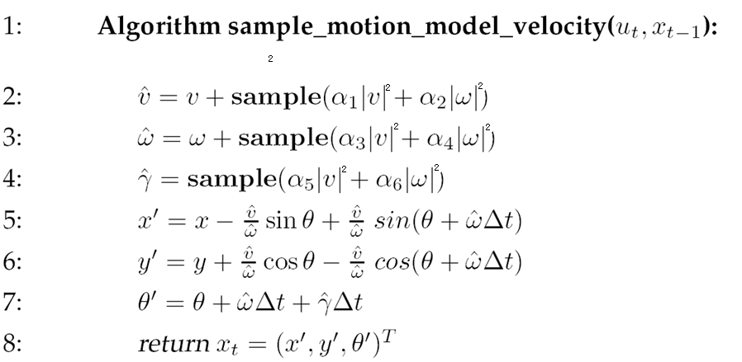
Monte Carlo Localization (MCL)
Motion model example:

Slide 4
Monte Carlo Localization (MCL)
Measurement model example:
Algorithm landmark_detection_model(z,x,m):
Return

Slide 5
Examples

Slide 6


Slide 7
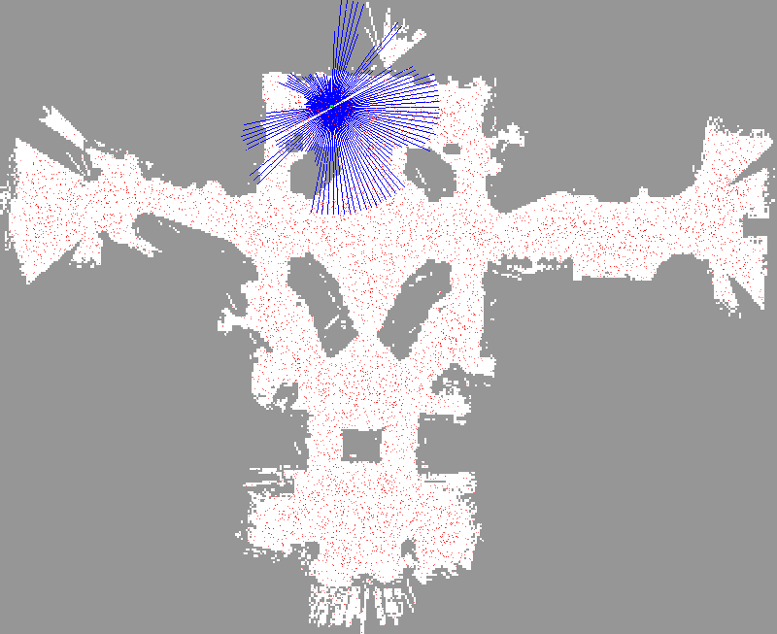

Slide 8


Slide 9
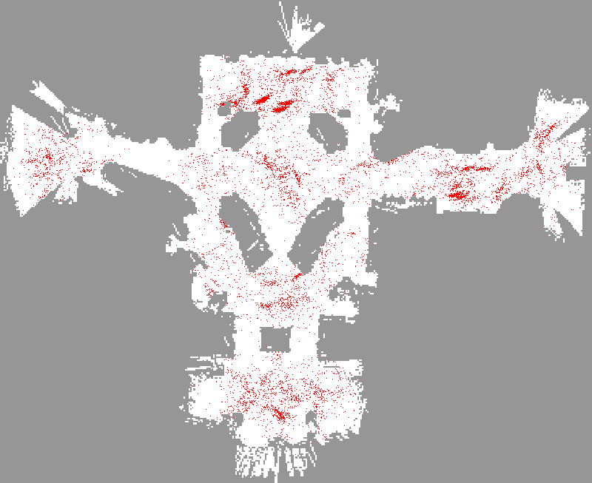

Slide 10
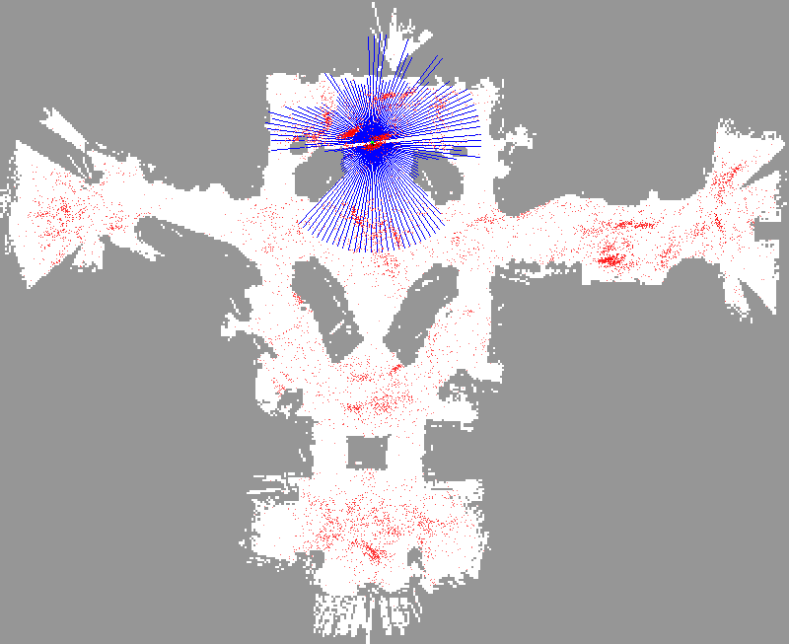

Slide 11
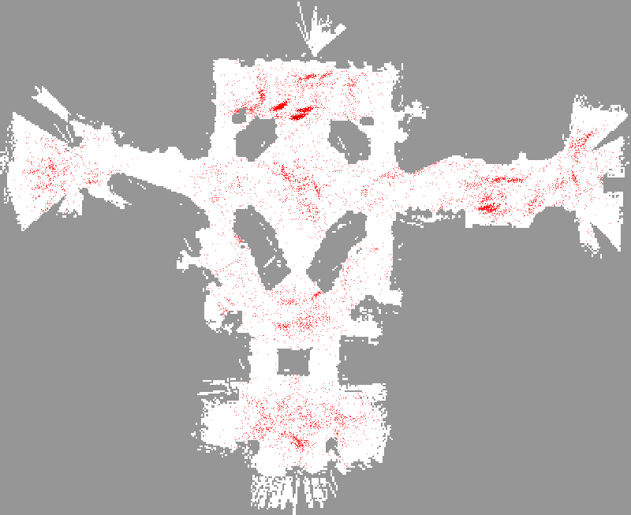

Slide 12


Slide 13
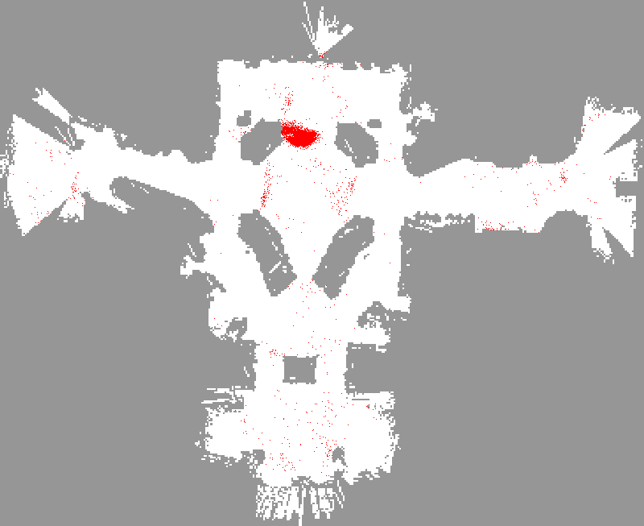

Slide 14
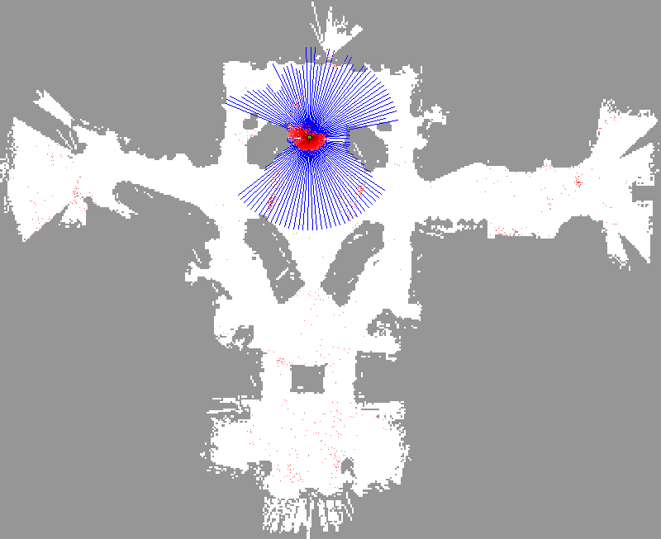

Slide 15


Slide 16


Slide 17


Slide 18
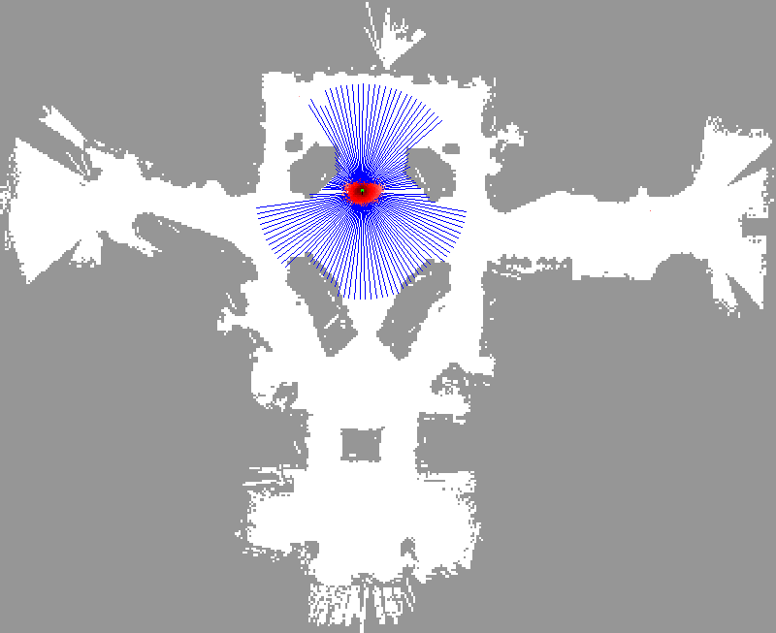

Slide 19


Slide 20


Slide 21


Slide 22
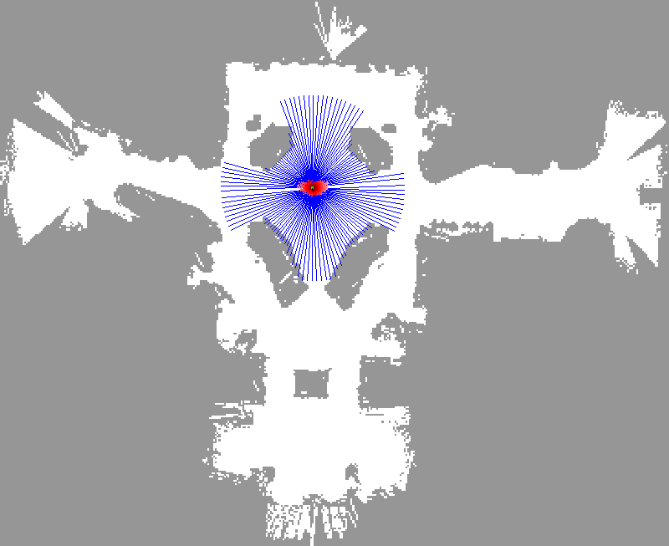

Slide 23


Slide 24
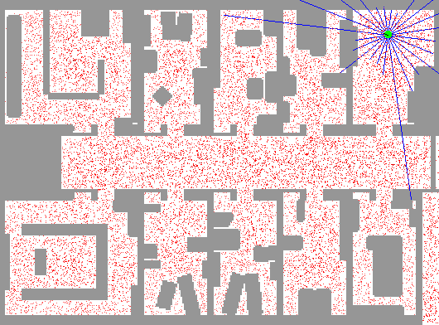
Sample-based Localization (sonar)

Slide 25

Initial Distribution

Slide 26

After Incorporating Ten Ultrasound Scans

Slide 27

After Incorporating 65 Ultrasound Scans

Slide 28

Estimated Path

Slide 29
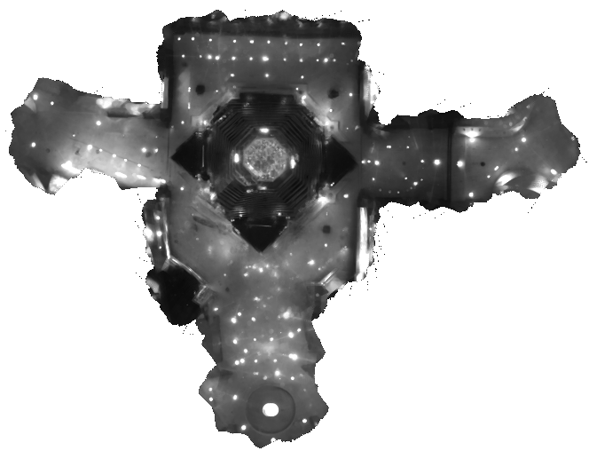
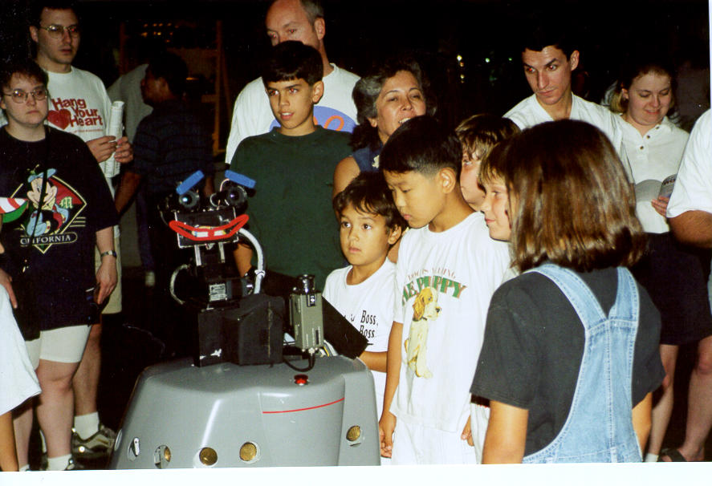

Slide 30

Robots in Action: Albert

Slide 31
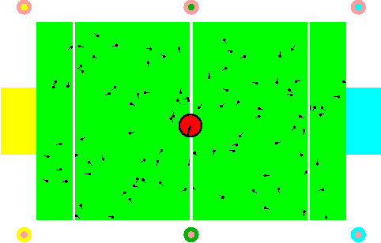
Localization for AIBO robots

Slide 32
Limitations
The approach described so far is able to
track the pose of a mobile robot and to
globally localize the robot.
1. How can we deal with localization errors (i.e., the kidnapped robot problem)?
2. How can we deal with the failures when sensors are accurate?
3. How to adapt the size of sample size?

Slide 33
1. Recovery from Failures: Approaches
How many？
What distribution？
Insert random samples proportional to the average likelihood of the particles (the robot has been teleported with higher probability when the likelihood of its observations drops).
Randomly insert samples (the robot can be teleported at any point in time).

Slide 34
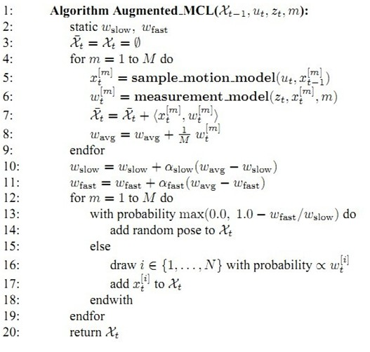
Approaches: Augmented MCL
Gutmann, J.S., and D. Fox. 2002. An experimental comparison of localization methods continued. IROS.
Gutmann, J.S. et al. 1998. An experimental comparison of localization methods. IROS

Slide 35
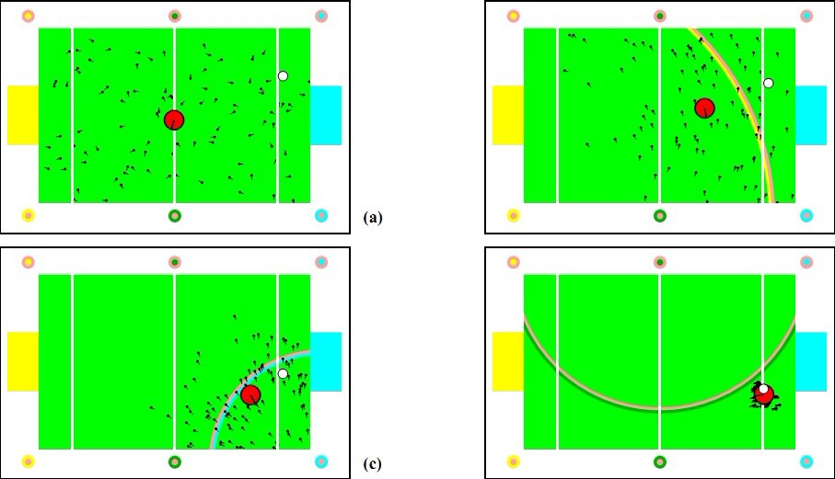
Recovery from Failure

Slide 36
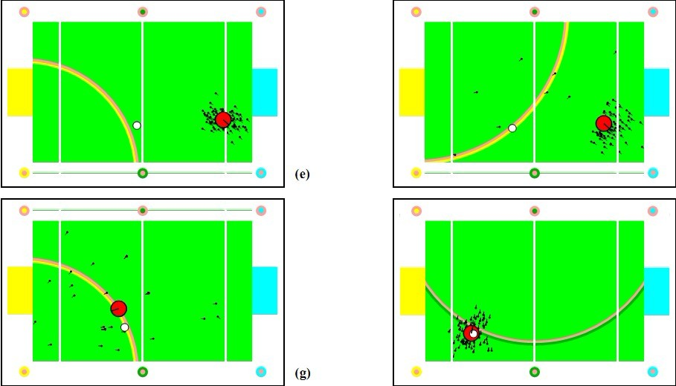
Recovery from Failure

Slide 37
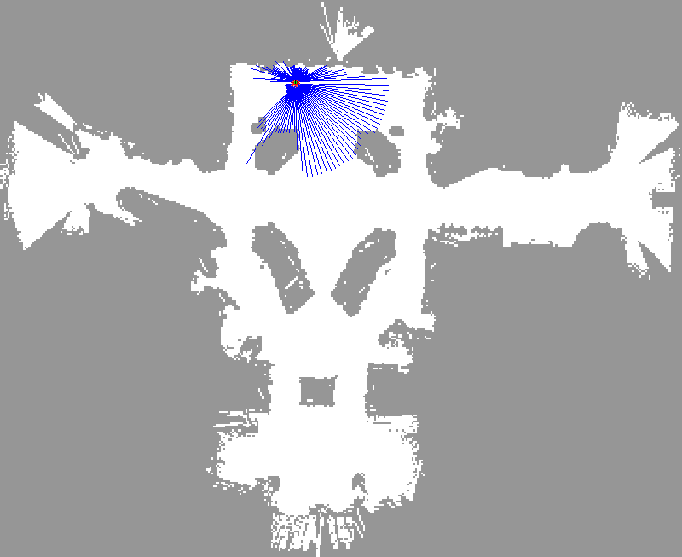
Recovery from Failure

Slide 38
KLD-sampling
Idea:
Assume we know the true belief.
Represent this belief as a multinomial distribution.
Determine number of samples such that we can guarantee that, with probability (1- δ), the KL-distance between the true posterior and the sample-based approximation is less than ε.
Observation:
For fixed δ and ε, number of samples only depends on number k of bins with support:
[Fox NIPS-01, Fox IJRR-03]

Slide 39
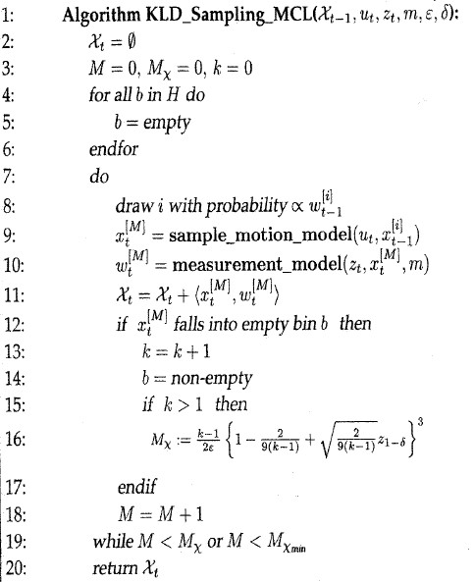

Slide 40
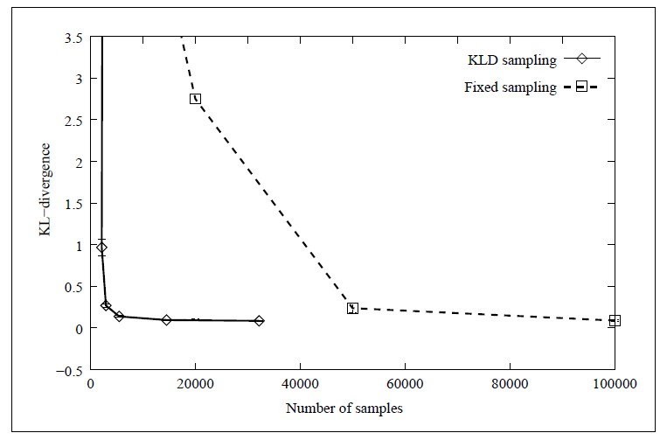
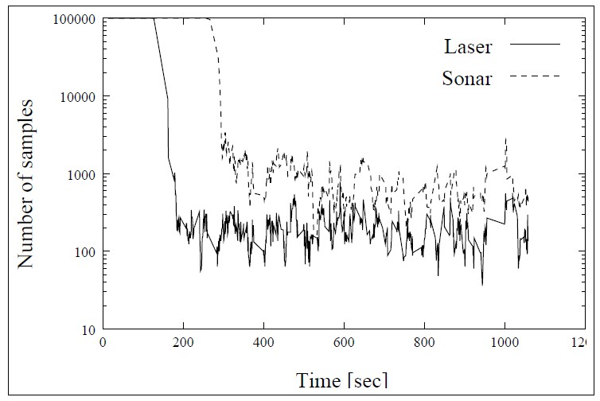
Evaluation

Slide 41
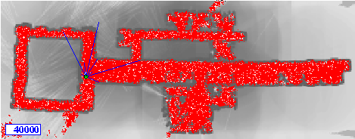
KLD-Sampling: Sonar
[Fox NIPS-01, Fox IJRR-03]

Slide 42

KLD-Sampling: Laser

Slide 43
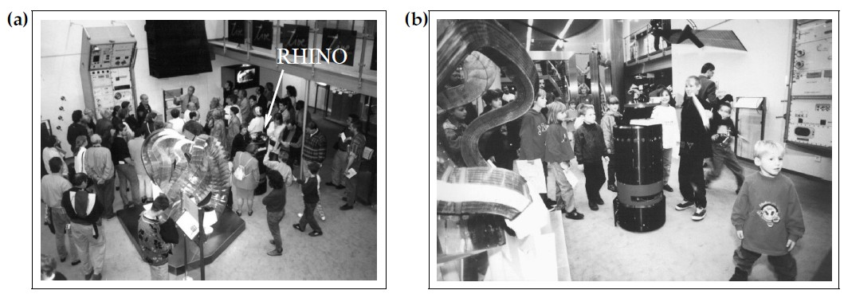
Localization in Dynamic Environments
State augmentation: including hidden state into the estimated state
Outlier rejection: reject measurements affected by hidden state √√√

Slide 44
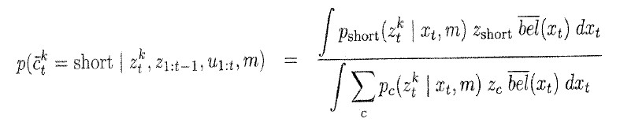
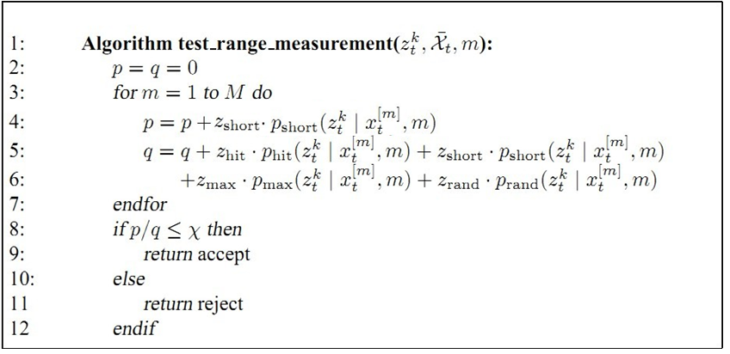
Outlier rejection

Slide 45
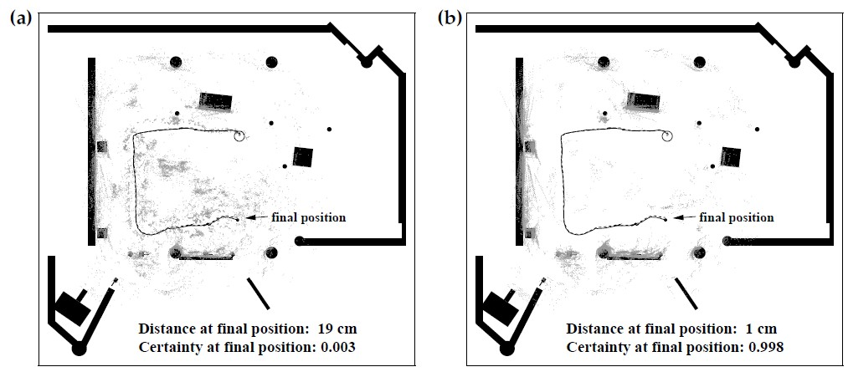
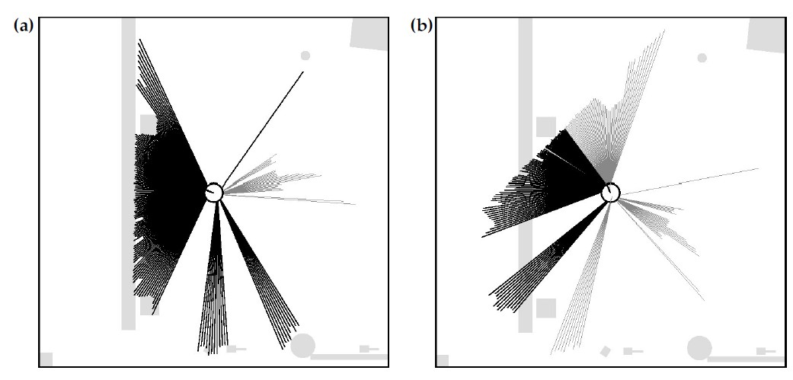

Slide 46
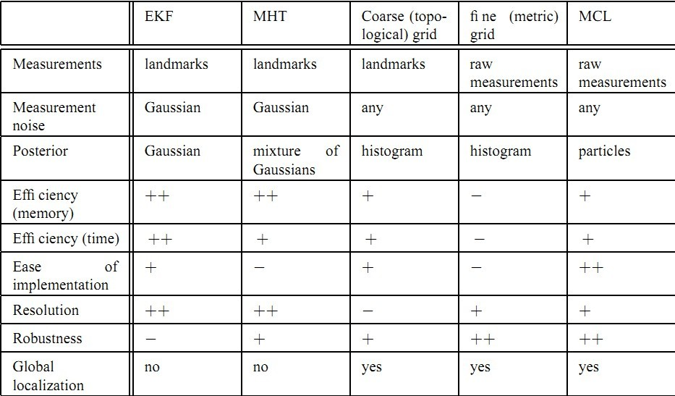
Comparison

Slide 47
Summary
Implement Particle filters in Global or Local localization: Monte Carlo Localization
Approaches to recovery from failures: Augmented MCL; Mixture MCL
Adapt the size of sample sets: Kullback-Leibler divergence based Sampling.
Localization in Dynamic Environments: Judge whether a measurement is a outlier

Slide 48
Homework
Read the following papers in details, and finish a report.
Gutmann, J.S., and D. Fox. 2002. An experimental comparison of localization methods continued. IROS.
2. Gutmann, J.S. et al. 1998. An experimental comparison of localization methods. IROS

